Slide 1
Parallax Occlusion Mapping
Law Smith & David Bocek

Slide 2
Problem
Not enough speed / memory for 3d details
Large stone bricks
Stones / sand
Bullet holes / destruction

Slide 3
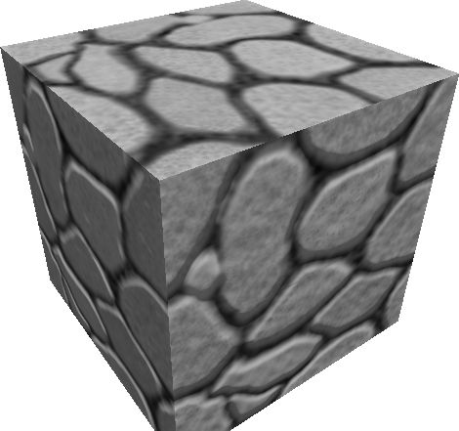
Problem
Normal mapping fails at grazing angles

Slide 4
Background
Parallax Occlusion Mapping (POM) [1]
Ex: CryEngine, Uningine (Oculus Rift)
Offset Textures on a plane
[1] Dynamic Parallax Occlusion Mapping with Approximate Soft Shadows - Tatarchuk

Slide 5
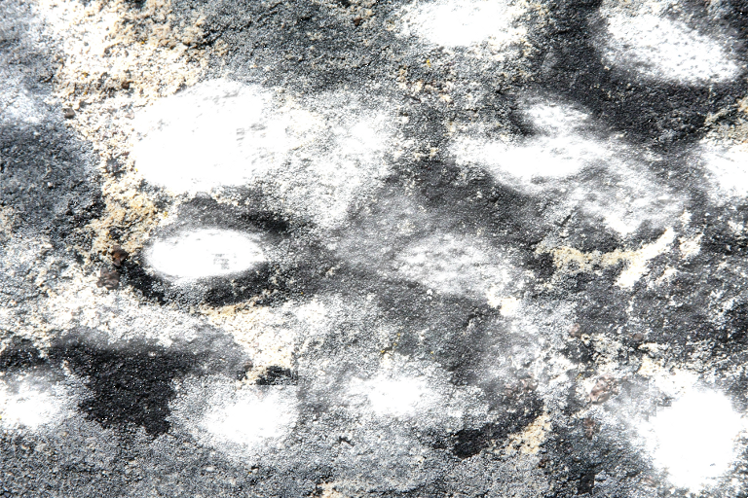
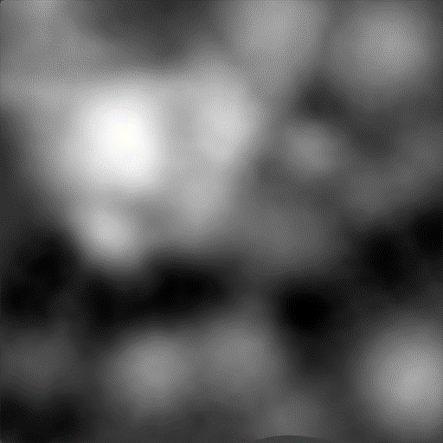
Approach
Texturemap AND heightmap
Change ray to 2D tangent space

Slide 6
Approach
Height curve along the tangent direction
From heightmap
Where the mesh would be if it was there
T
h
0.0
1.0

Slide 7
Approach
Discretize curve
Adjust (u,v) cords based on intersection
T
Offset
h
0.0
Offset
Desired (u,v)
Hit (u,v)
1.0

Slide 8
Approach
Cast ray to lights for shadows
T
h
0.0
1.0

Slide 9
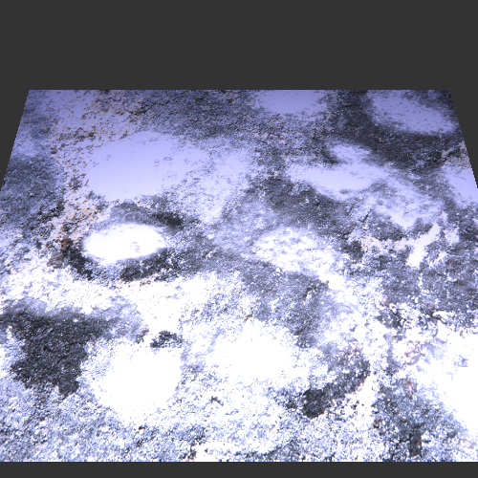
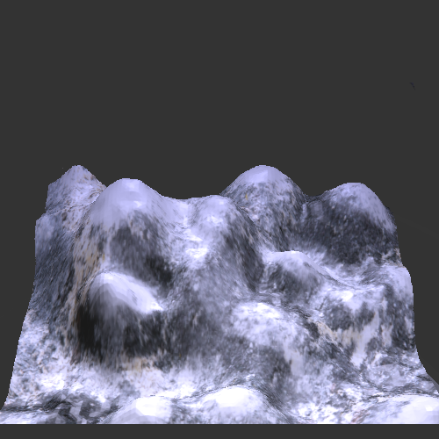
Parallax Occlusion Mapping
Standard Texture Mapping

Slide 10

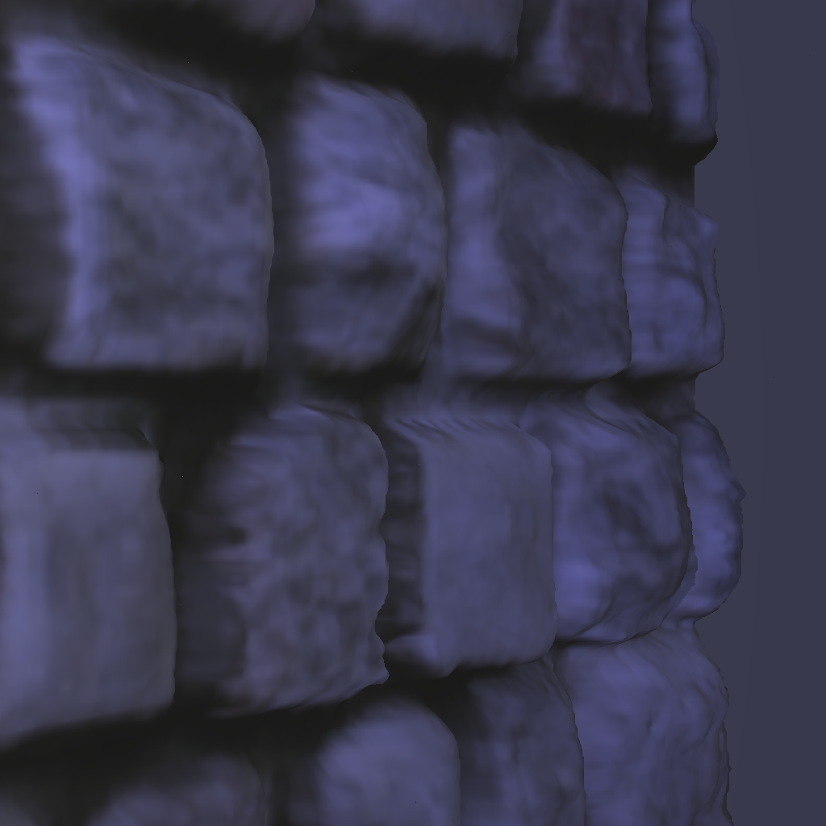

Slide 11
Questions?
http://developer.amd.com/wordpress/media/2012/10/Dachsbacher-Tatarchuk-Prism_Parallax_Occlusion_Mapping_with_Accurate_Silhouette_Generation(SI3D07).pdf
http://ati.amd.com/developer/techreports/2006/I3D2006/Tatarchuk-POM-SI3D06.pdf

